Slide 1
WEBFRAMEWORKS PROJECT
,

Slide 2
HOTEL MANAGEMENT
The website takes care of hotel booking of various departments of particular hotel like clubs ,party halls ,etc by signing up to the page.
In the project we had done sign in , login and forms using Django and developed the pages.

Slide 3
Link:
Github link after using Django:
https://github.com/Supriya127/my-first-blog.git
Github link before using Django:
https://github.com/Supriya127/hotel-management

Slide 4
INDIVIDUAL CONTRIBUTION
KONA SUPRIYA :
WORKED ON SIGNUP PAGE
WORKED ON DESIGING THE PAGES
PRAKRUTHI KS:
WORKED ON LOGIN PAGE
WORKED ON DESIGING THE PAGES
JYOSNA S:
WORKED ON SIGNUP PAGE
WORKED ON DESGING THE PAGES

Slide 5
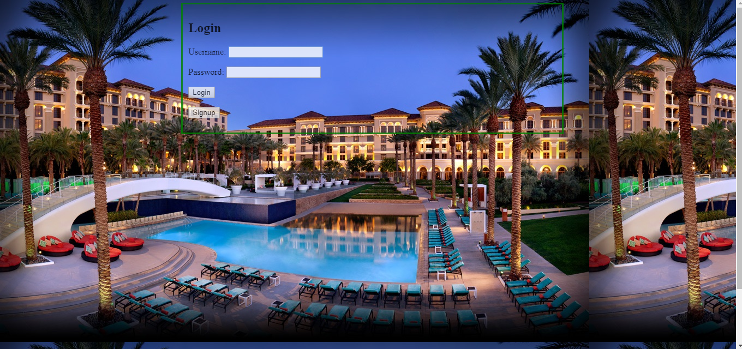
.

Slide 6
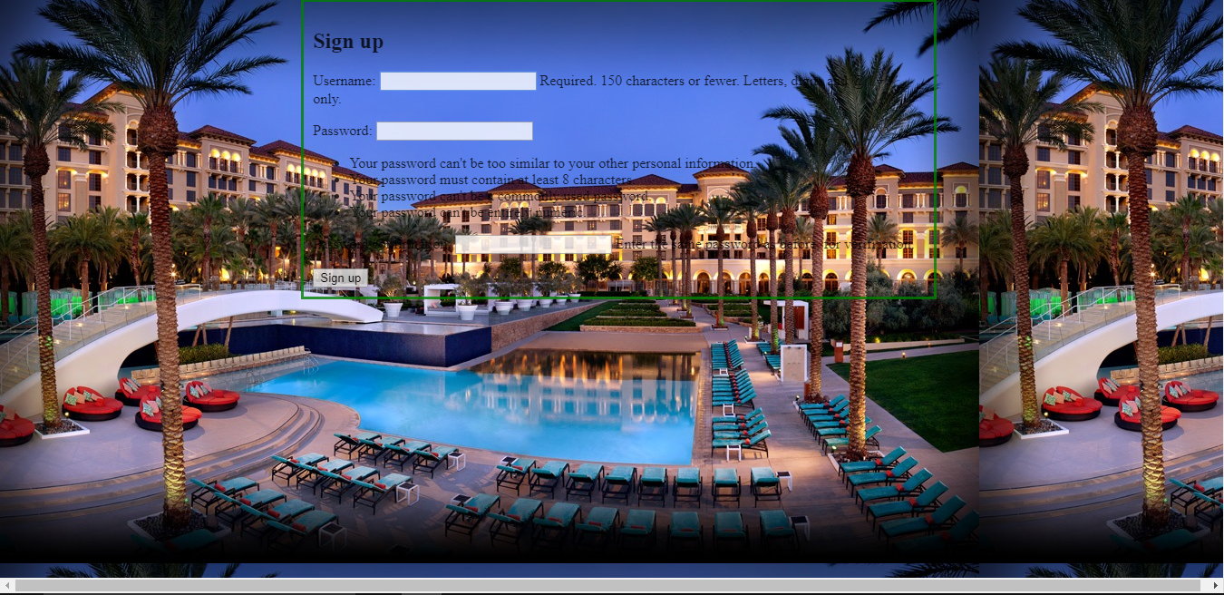

Slide 7
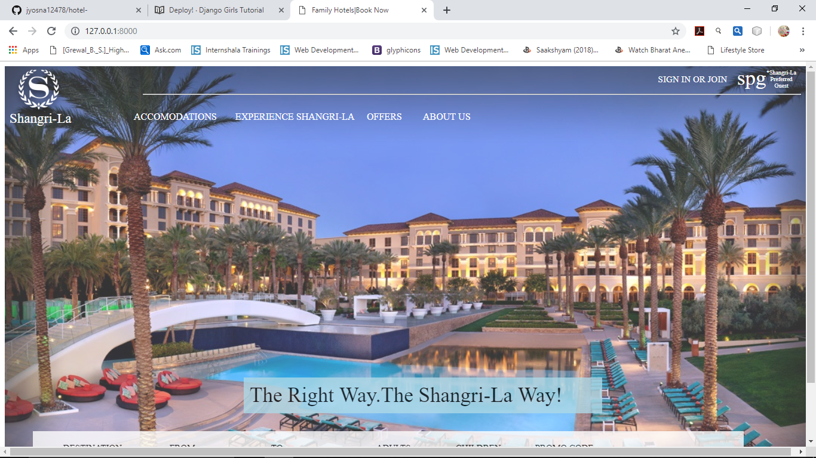
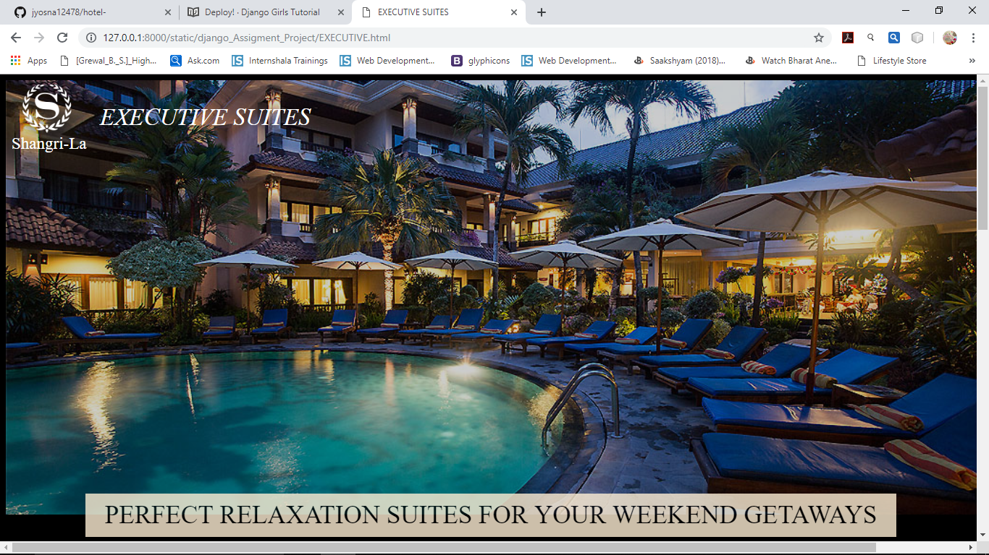

Slide 8
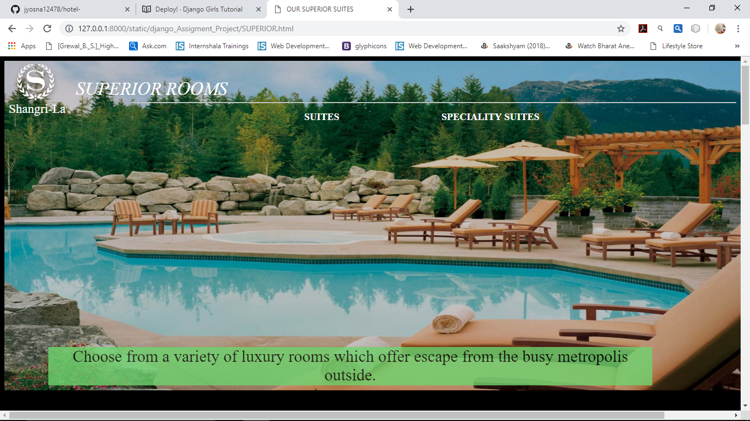
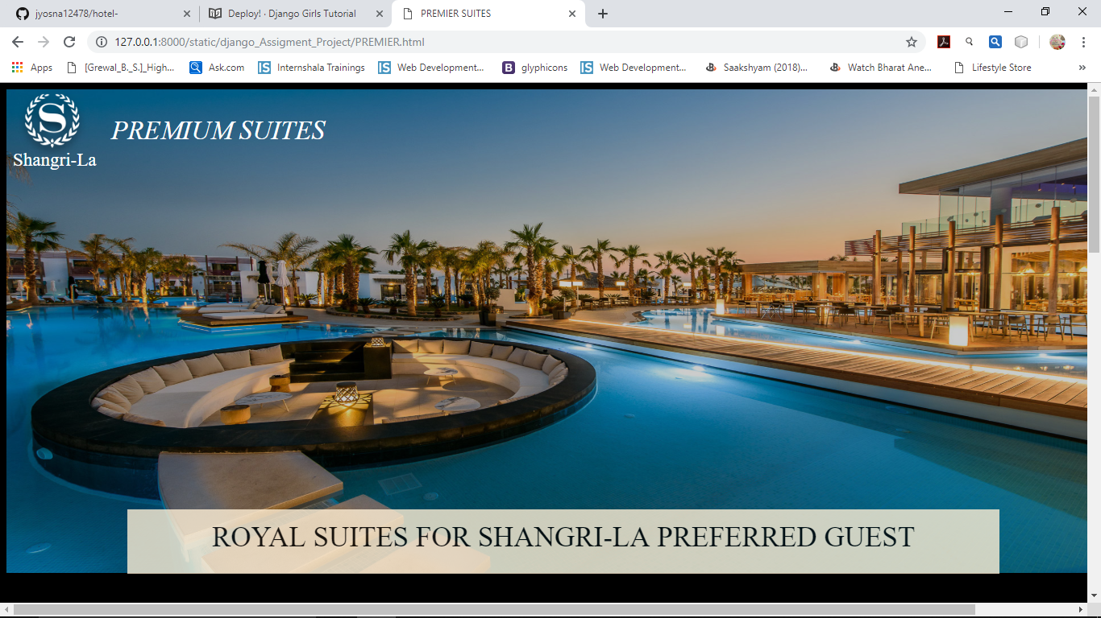

Slide 9
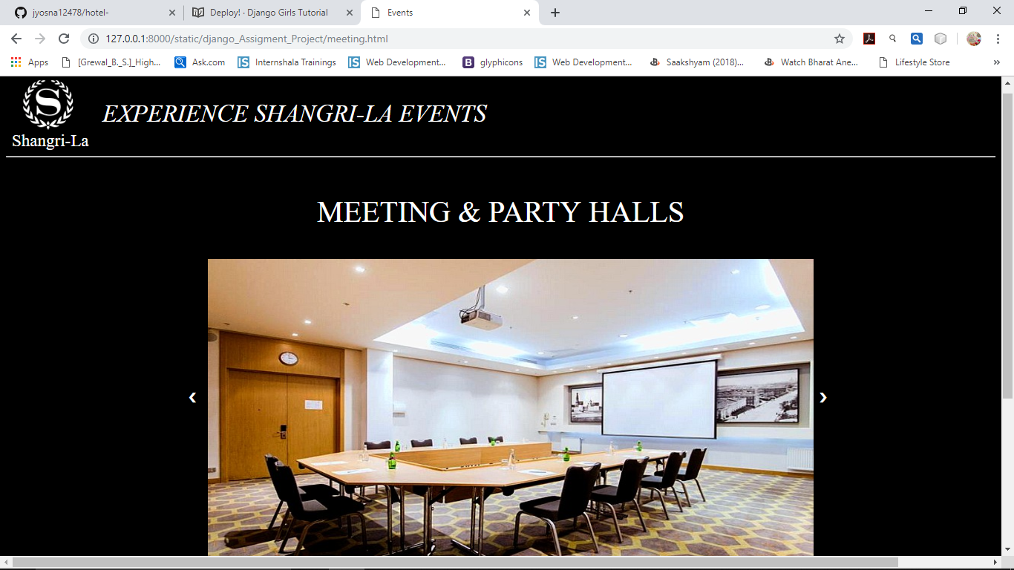
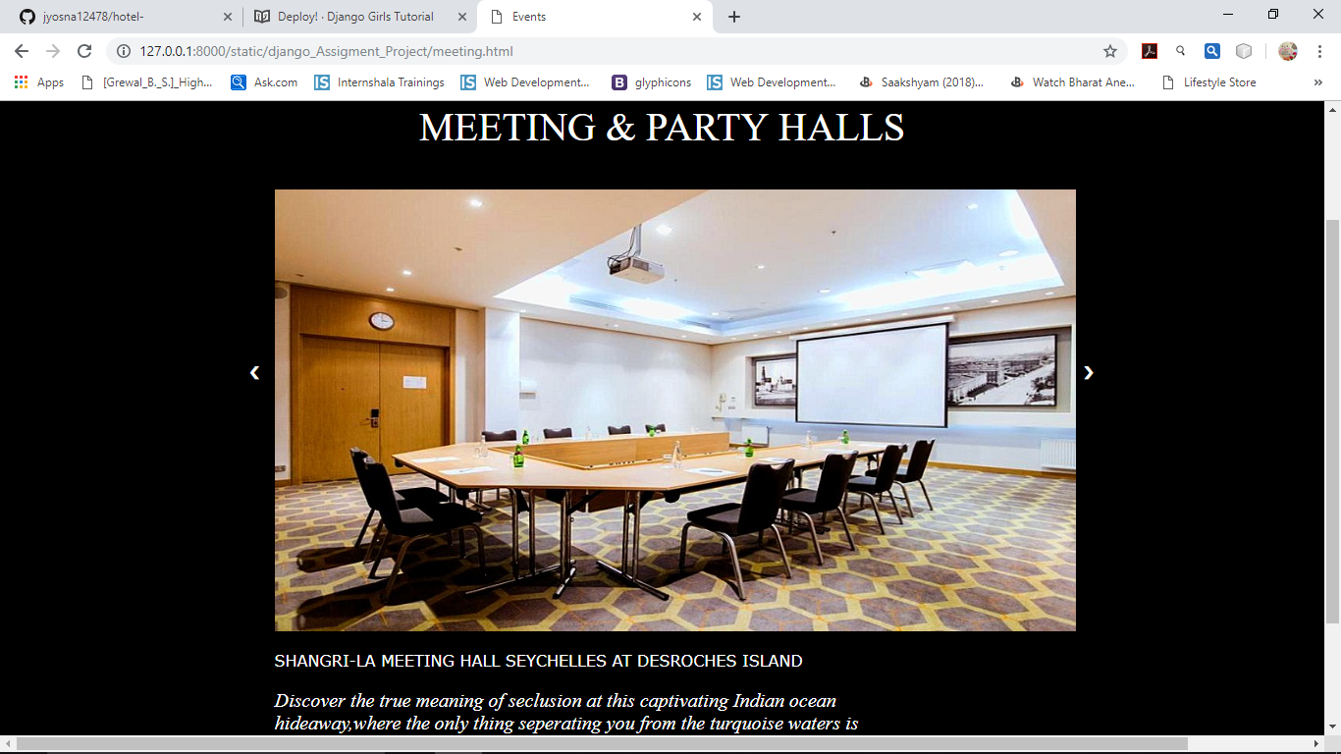

Slide 10
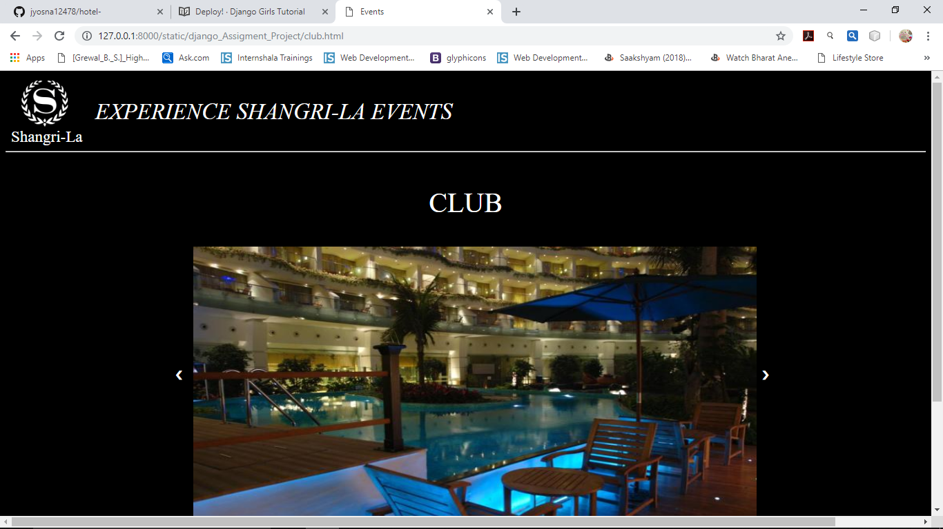
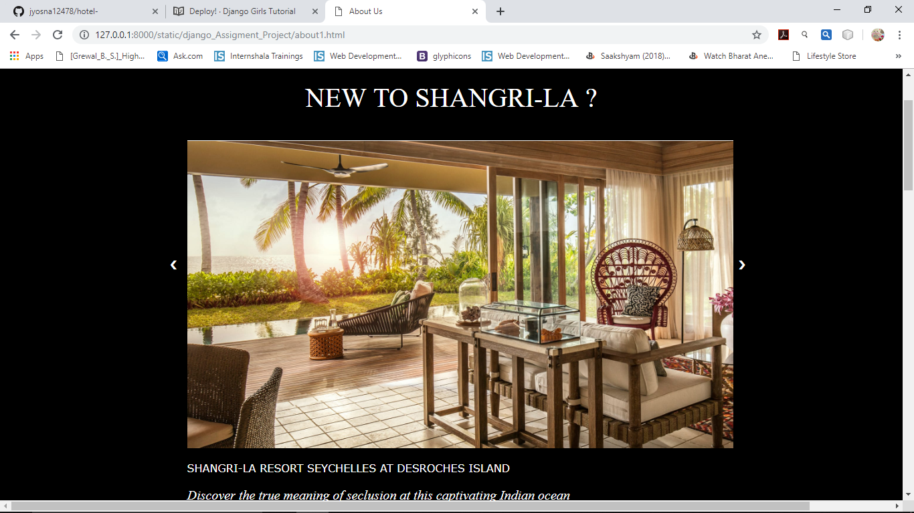

Slide 11
Challenges:
It is very simple is create sign up Authentication Validation ,since Django takes care of all the internal functionalities.
Since the concepts are very abstract and everything works like it is inside a black box
For beginners understanding and working with Django is challenging

Slide 12
TAKEAWAYS:
In order to create a signup page in conventional fashion , We have to write code for the logic, validation , queries, create tables in the data base and provide connection to the database.
But you don’t have to do anything Django does everything for us.Creating tables , queries , everything is abstract
Hence creating applications in Django is very simple, consumes very less time and reliable

Slide 13
CONTACT INFO:
NAME: PRAKRUTHI K S
USN: PES1201700842
GMAIL: prakruthihallikar7679@gmail.com
NAME: JYOSNA S
USN: PES1201700792
GMAIL: hema.m456@gmail.com
NAME: KONA SUPRIYA
USN: PES1201701117
GMAIL: kona127supriya@gmail.com

